Slide 1

WELCOME
NAVFAC SOUTHWEST

Slide 2

Pay Periods/ Pay Days:
  A pay period consists of two calendar weeks. It begins on a Sunday and ends on the second Saturday two weeks from now.
  Paydays are every other Friday.
  As a new employee, you should receive your paycheck in three weeks which is your salary earned for the pay period you just completed.

Slide 3
Rates of Pay:
  General Schedule (GS, white collar)
  https://www.opm.gov/policy-data-oversight/pay-leave/salaries-wages/
  Federal Wage System (FWS, wage grade, WT, WG, WL, WS, blue collar)
    https://wageandsalary.dcpas.osd.mil/BWN/AFWageSchedules/
  All salaries are reviewed annually plus compared to private industry salaries and cost of living allowances.
Notes:
GS

Slide 4
Work Schedule
Work Week:
  Will be set by your supervisor
  Work hours and shifts vary within the normal 80-hour pay period (two weeks)
  Contact your supervisor with any questions regarding work schedules

Slide 5
2026 Federal Holidays
Thursday, January 01 | New Year’s Day
Monday, January 19 | Birthday of Martin Luther King, Jr.
Monday, February 16 | Washington’s Birthday
Monday, May 25 | Memorial Day
Friday, June 19 | Juneteenth National Independence Day
Friday, July 03 | Independence Day
Monday, September 07 | Labor Day
Monday, October 12 | Columbus Day
Wednesday, November 11 | Veterans Day
Thursday, November 26 | Thanksgiving Day
Friday, December 25 | Christmas Day
Notes:
Federal law (5 U.S.C. 6103) establishes 11 public holidays

Slide 6
Pay Information
Time and Attendance:
  As a federal employee, you must be ready, willing and able to work at your assigned work schedule.
  If you are unable to come to work or if you will be late, you are responsible for contacting your supervisor within 2hrs of your scheduled work time.
  Contact your supervisor to determine how your command documents your Time and Attendance.

Slide 7
Position Descriptions (PD’s):
  Outlines the duties you have been hired to perform
  Determines the title and grade of your job
  PD should not be shared or should not be copied for others; it is strictly for personal use only.
  Please review your PD and discuss with your supervisor whether you are required to file a new entrant Confidential Financial Disclosure Report (OGE Form 450). If required, you must file the new entrant OGE Form 450 within thirty (30) days from entering your new position.

Slide 8
Annual Leave
Annual Leave
  Enables you to take time off for vacation or personal business
  Based on number of years employed in federal service and work schedule whether it’s Full-time or Part-time
    0-3 yrs: 4 hrs
    3-15 yrs: 6 hrs
    15+ yrs: 8 hrs
  Leave requesting procedures are in accordance with NAVFACSWINST 12000.1A
  For bargaining unit employees, please refer to the applicable collective bargaining agreement for appropriate leave requesting procedures

Slide 9
Sick Leave
Sick Leave:
  Based on your inability to work due to illness, medical, dental or optical appointment and/or treatment
  Full-time employees earn sick leave at the rate of
  4 hrs per pay period.
  Leave requesting procedures are in accordance with NAVFACSWINST 12000.1A
  For bargaining unit employees, please refer to the applicable collective bargaining agreement for appropriate leave requesting procedures

Slide 10
Government Retirement and Benefits (GRB) Platform
Allows employees to conduct electronic benefits transactions and
access general and personal benefit information
  Federal Employees’ Health Benefits Plan (FEHB)
  Federal Employees’ Group Life Insurance (FEGLI)
  Retirement
  Thrift Savings Plan (TSP)
New employees will have to wait approximately 5 working days to
establish an account
Benefits Line: 1-888-320-2917 or email navybenefits@us.navy.mil
GRB Platform Website: https://civbenefits.dc3n.navy.mil/
For additional information visit: https://portal.secnav.navy.mil/orgs/MRA/DONHR/Benefits/CBC%20Local%20Forms/CBC%2012800-31%20Benefits_Information_for_Newly_Hired_Employees_Entitled_to_Benefits.pdf

Slide 11
Federal Employees’ Group Life Insurance (FEGLI)
2 Types of FEGLI:
  Basic Life Insurance
    Automatically enrolled in Basic life insurance
    If you do not want Basic coverage, you must waive the coverage
  Optional Life Insurance
    Option A – Standard
    Option B – Additional
    Option C – Family
      $5,000 For A Spouse
      $2,500 For Each Eligible Dependent Child
    https://www.opm.gov/retirement-services/calculators/fegli-calculator/
You have 60 days from the date you start work to sign up for any Optional life insurance.
Temporary employees are not eligible to enroll in life insurance

Slide 12
Retirement
Federal Employees Retirement System (FERS)
  Covered if hired after December 31, 1983
  Components are: FERS Basic Benefit Plan, TSP and Social Security.
  FERS: You contribute a percentage of your wages each pay period, depending on when you were employed by Federal Government.
  Social Security: Automatically contribute 6.2% of your earnings up to the max taxable wage base to Social Security & 1.45% to Medicare
  Temporary employees are not eligible to pay into retirement
Notes:
FERS - FERS employees contribute 4.4% of wages.
If you were hired before the cutoff in 1983, then you fall under CSRS

Slide 13
Online Retirement Application (ORA)
Retirement application must be submitted through the Office of Personnel Management’s (OPM) Online Retirement Application (ORA) website.
To create an ORA account, employees will need to access the Common Access Card (CAC)-enabled SECNAV Portal and submit a CANYON ticket. https://portal.secnav.navy.mil/ess/SR/Portal/Workspaces/Home.aspx
Creating an ORA account does not immediately allow you to submit a retirement application. Before submission privileges are enabled, your retirement eligibility must first be reviewed and confirmed by the Civilian Benefits Center. This review process takes time and may result in a delay between account creation and the ability to submit your application.

Slide 14
Thrift Savings Plan (TSP)
Automatic enrollment into TSP applies to all newly hired or rehired employees on or after October 1, 2020, at a contribution rate of 5% of your basic pay each pay period. If you were newly hired or rehired between August 1, 2010 and September 30, 2020 you were automatically enrolled at 3%.
If you are a civilian and you were enrolled on or after September 5, 2015, unless you choose another investment option, all contributions received by the TSP will be deposited into the Lifecycle (L) Fund most appropriate for your age.
Your demographic information sent from your agency to the TSP affects the operation of your TSP account. We encourage you to review your earnings and leave statements, as well as your TSP statements, to ensure that your TSP account information is accurate.
Notes:
Key Points:
- It’s the Government version of private industry 401K.
- Any changes and/or termination can be done through GRB or contact the Benefits Line.

Slide 15
Thrift Savings Plan (TSP)
You can determine the amount or percentage you want to invest and which funds to invest in.
Contributions are tax deferred and based on your current retirement plan
FERS:
  Agency Automatic 1% Contribution
  Agency matching contributions up to 5%
    First 3% match dollar to dollar
    Remaining 2% match 50 cents per dollar
CSRS:
  NO agency automatic or matching contributions
For additional information, contact TSP at 1-877-968-3778 or go to https://www.tsp.gov/planning-for-life-events/

Slide 16
Designation of Beneficiary
Life Insurance, Retirement, Thrift Savings Plan, and unpaid compensation benefits are payable to the beneficiary designated by you
Designation must be in writing, signed, witnessed, and received by OCHR-SE (with the exception of TSP)
Keep this designation CURRENT
  Changes in family status, without a corresponding change in designation of beneficiary, may result in a settlement other than intended (i.e. Birth/Adoption of a child, Marriage, Divorce, etc.)
Notes:
All forms have the mailing address of where to send your completed document.

Slide 17
Federal Employees’ Health Benefits (FEHB)
Enrollment:
  If you are hired under a career or career-conditional appointment, you have 60 days from the date you start work to choose a health insurance plan or elect not to enroll.
  If you are hired under a full-time temporary appointment that is expected to last AT LEAST 90 days, you have 60 days from the date you start work to choose a health insurance plan or elect not to enroll
Effective Dates:
  Health plan coverage will become effective one full pay period after you submit your transaction in GRB Platform.
  If you choose to see your provider before you receive your health insurance card, you may bring a copy of your enrollment form to the office to show evidence of coverage.

Slide 18
Federal Employees’ Health Benefits (FEHB)
If you decide NOT to elect FEHB coverage at this time, you will have to wait until the next Open Season to enroll or you would have to meet one of the “Life Events” listed on the FEHB application in order to apply and receive coverage.
Open Season
  Once annually which usually occurs in mid November
  During open season you may enroll or change plans/ type of enrollment
Life Events
  Birth of a child, marriage, adoption of a child, loss, etc.
Notes:
Refer to the new employee handbook in your packet.

Slide 19
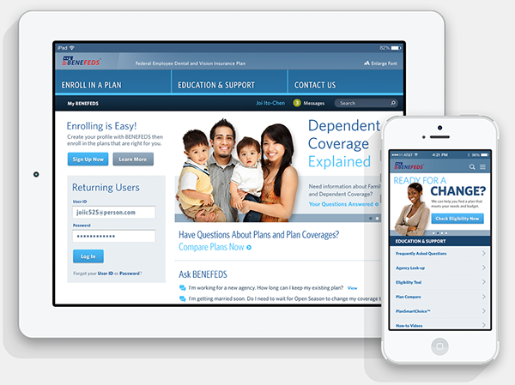
Federal Employee Dental and Vision Plan (FEDVIP)
FEDVIP provides supplemental Dental & Vision coverage. This is additional dental & vision coverage, separate from what may be provided under your health insurance plan.
If you want to elect FEDVIP coverage you must sign up within 60 days of your entry on duty at https://www.benefeds.com/
For more information about the FLTCIP, please contact Long Term Care Partners at 1(800)582-3337

Slide 20
Flexible Spending Account (FSA)
You contribute money from your salary BEFORE taxes are withheld then get reimbursed for your out-of-pocket Health Care such as eligible medical/dental expenses and Dependent Care expenses such as child and/or adult care.
If you want to elect to contribute to a Flexible Spending Account, you must sign up within 60 days of your entry on duty https://www.fsafeds.com or 1-877-372-3337
If you are hired on or after October 1, you are ineligible to participate in that plan year, however you can elect during the open season for the following plan year.
Notes:
You can contribute up to a maximum of $3,050.00See contribution information* to your Health Care FSA each year. Keep in mind, you may carry over up to $610.00 remaining in your account from one plan year to the next.

Slide 21
Deposits & Re-deposits- Crediting Military, Temp and
Refunded Service Towards Retirement
Employees with prior military or Federal service may need to pay a deposit or redeposit in order to receive credit towards retirement.
Federal employees, who are retired military, may be able to gain service credit for their military service time for purpose of computing their total annuity under either the CSRS or FERS program.
For further information please refer to the Handout in your packet.
Notes:
Service Credit (opm.gov)

Slide 22
Military Buy Back
If you have any prior active-duty military service, you may be eligible to buy back that time.
  To proceed with this request, you must “buy back” your military service time. You will be required to obtain your estimated earnings from the appropriate military finance center prior to starting the process.
  Complete a separate Estimated Earnings During Military Service request form (RI 20-97) for each branch and attach your DD-214 (member 4 copy).
  Obtain a package from your HR Representative.

Slide 23
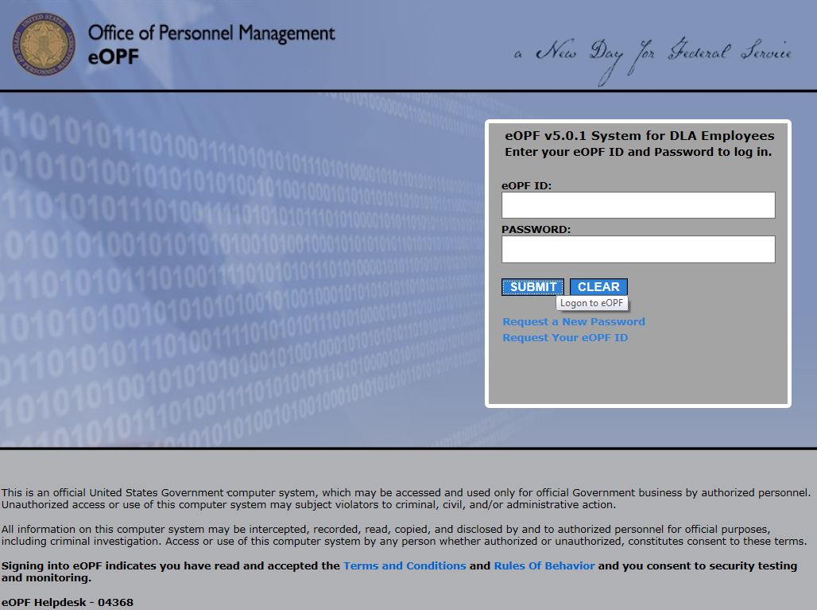
Electronic Official Personnel Folder (eOPF):
A file containing records of an individual's federal employment career such as Notification of Personnel Action (SF50), Benefit selections/ beneficiaries, etc.
  eOPF website: https://eopf.opm.gov/navy/

Slide 24
Questions?

Slide 25
Break
Please be prompt
NAVFAC SOUTHWEST (Day – 1)

